Slide 1
Habitual goals
Adam Morris & Fiery Cushman

Slide 2
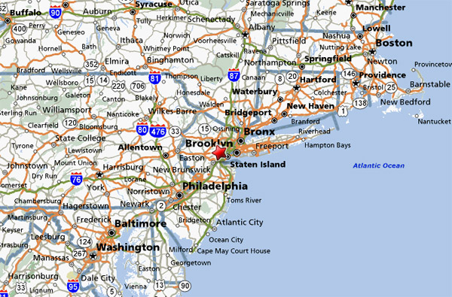
Notes:
- Drive from NJ to Providence

Slide 3

River Rd
22 east
I-287
I-95
Exit 22A
“When I’ve turned left, good things have happened. Turn left!”
Providence
Goal-directed planning
Habitual action
Flexible, slow
Inflexible, fast
Notes:
Two ways
Goal-directed planning
Hierarchy
Using causal knowledge, plan down the chain
Habit
Fork in the road
Both converge; tradeoffs
Devaluation

Slide 4


Problem of goal selection
I-78
Merritt
I-287
I-95
Exit 22A
Exit 22B
Exit 47
Providence
Notes:
Often treated as separate, competing. Recently, more interaction.
Purpose: show a critical interaction, solves major problem for goal-directed planning, cool philosophical implications
Problem of goal selection
Other subgoals
Doesn’t just apply to subgoals
Standard approach: evaluate each
Impossible; need a fast way

Slide 5
River Rd
22 east
I-287
I-95
Exit 22A
“When I’ve turned left, good things have happened. Turn left!”
Providence
Goal-directed planning
Habitual action
Habitual goals:
When I’ve chosen I-287 as a goal, good things have happened. Plan towards I-287!
Notes:
One potential solution: allow the habitual system to select, not just actions, but goals/subgoals
Allows efficient selection of goals, while retaining flexibility in planning towards them

Slide 6
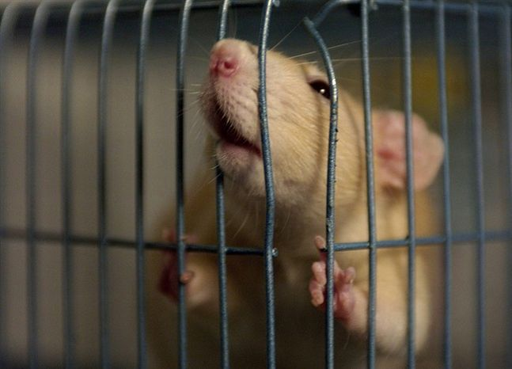

Experimental design

Slide 7
Experimental design
Goal-directed planning
1
2
If x > y, plan towards
If y > x, plan towards
Habitual action
Has
1
or
2
$x
$y
$z
led to more reward?
Habitual action system uniquely predicts increase in selecting action 1 after z=reward
(Gläscher et al. 2010)
Notes:
Original design
Actions, colors, transitions, rewards
Two systems
To goal-directed, orange (and z) is irrelevant
Critical trial

Slide 8
Experiment 1
Goal-directed planning
1
2
3
4
If x > y, plan towards
If y > x, plan towards
Habitual action
Has
1
2
3
or
4
$x
$y
$z
led to more reward?
Habitual goal
Habitual goal system uniquely predicts increase in selecting action 2 after z=reward
Has planning towards
or
led to more reward?
Notes:
Our design
Same-goal options, TWO OPTIONS PER TRIAL
We informed people of structure
Critical trial

Slide 9
Experiment 1
*
Goal selection can be under habitual control
Notes:
Explanation of effect
Implication

Slide 10
Experiment 2
1
2
3
4
6
10
11
16
21
0
$x
$y
$z
$x
$y
$z
Notes:
Replication, genuine planning towards goals
New design
Summing
Critical trial
Novel option sets

Slide 11
Experiment 2
1
2
3
4
4
12
9
16
21
0
$x
$y
$z
$x
$y
$z
Notes:
Replication, genuine planning towards goals
New design
Summing
Critical trial
Novel option sets

Slide 12
Experiment 2
Goal-directed planning
4
12
9
If x > y, plan towards
16
If y > x, plan towards
21
16
21
0
Habitual action
$x
$y
Has 1, 2, 3, … , 15 led to more reward?
$z
Habitual goal
Has planning towards
16
or
21
led to more reward?
Notes:
New design
Summing
Critical trial
Novel option sets

Slide 13
Experiment 2
Goal-directed planning
8
8
13
If x > y, plan towards
16
If y > x, plan towards
21
16
21
0
Habitual action
$x
$y
Has 1, 2, 3, … , 15 led to more reward?
$z
Habitual goal
Habitual goal system uniquely predicts increase in summing to 16 after z=reward
16
Has planning towards
or
21
led to more reward?
Notes:
New design
Summing
Critical trial
Novel option sets
Why this is nice

Slide 14
Experiment 2
*
Goal selection can be under habitual control

Slide 15
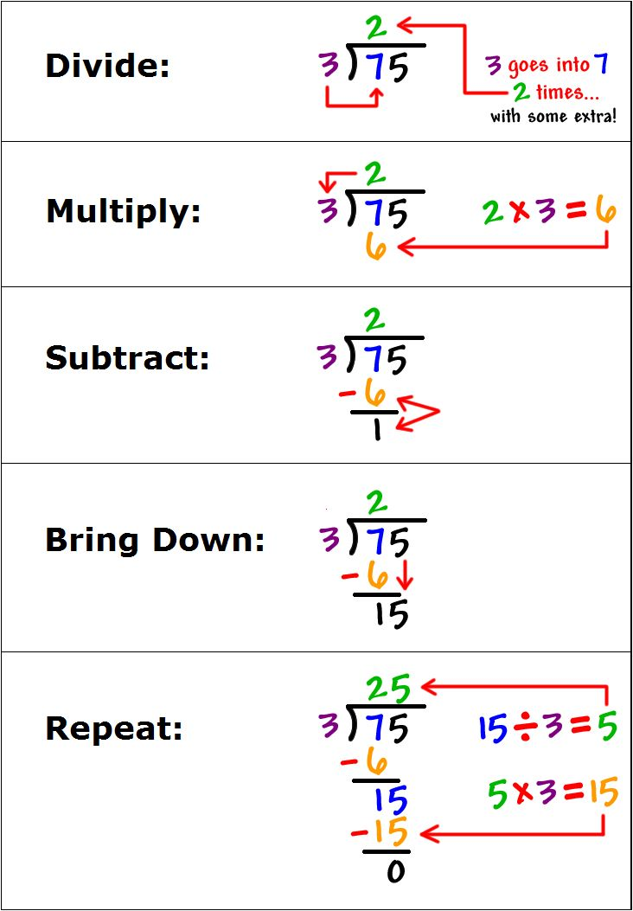
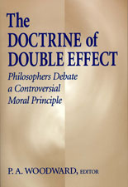
Applications
Notes:
Addiction
Complex cognitive tasks
Doctrine of double effect

Slide 16

Thank you!
In collaboration with:
Fiery Cushman
Contact: adammorris@g.harvard.edu

